Slide 1
MID PRESENTATION
CodeLens
An Enhanced Code Visualization and Quality Analysis System
Farjana Sarker Naima - BSSE1449
Supervised by Dr. Naushin Nower

Slide 2
AGENDA
What we'll cover today
01
Project Overview
A plain-language map of how CodeLens works, for everyone in the room
02
Functional Requirements
13 functional requirements from the SRS, mapped to later feature slides
03
System & Data Modeling
Use case, activity, ER diagrams, and the AI engineering pipeline from the SRS
04
Live System Walkthrough
Screenshots of every working feature in the running application
05
Project Status
What's completed, in progress, and remaining
06
Challenges Faced
The major hurdles encountered during development
02

Slide 3
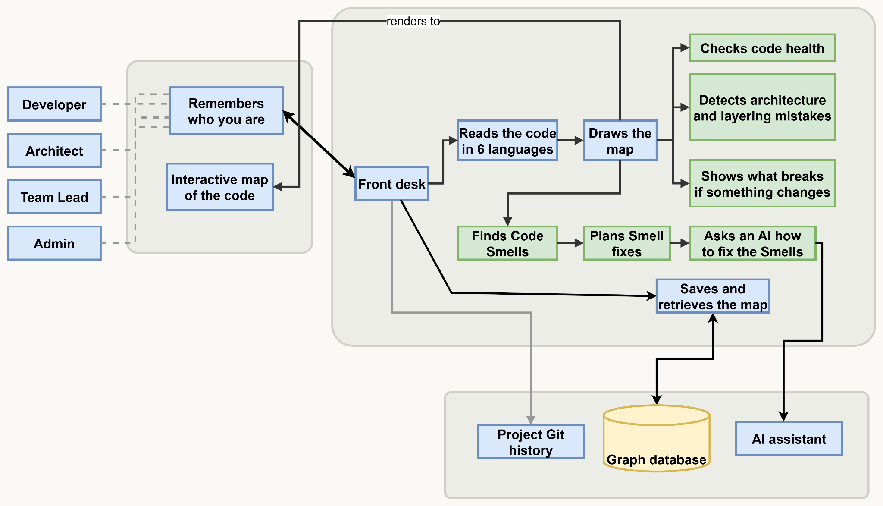
GETTING ORIENTED
Project Overview — How CodeLens Works
03

Slide 4
GETTING ORIENTED
Functional Requirements
FR-1
Code Upload & Ingestion
FR-2
Multi-Language Parsing & Metrics
FR-3
3-Tier Graph Visualization
FR-4
Search
FR-5
Architecture Pattern Detection
FR-6
Layer Violation Analysis
FR-7
Code Smell Analysis & AI Refactor Plan
FR-8
Change Impact Analysis
FR-9
Dependency Risk Scoring
FR-10
Dead Code Detection
FR-11
Code Metrics Dashboard
FR-12
Git History & Evolution Tracking
FR-13
Session Management
13 functional requirements from the SRS — each covered by a live feature later in this deck.
04

Slide 5
SECTION 1 OF 4
System & Data Modeling
Use case, activity, and entity-relationship diagrams from the SRS
05

Slide 6
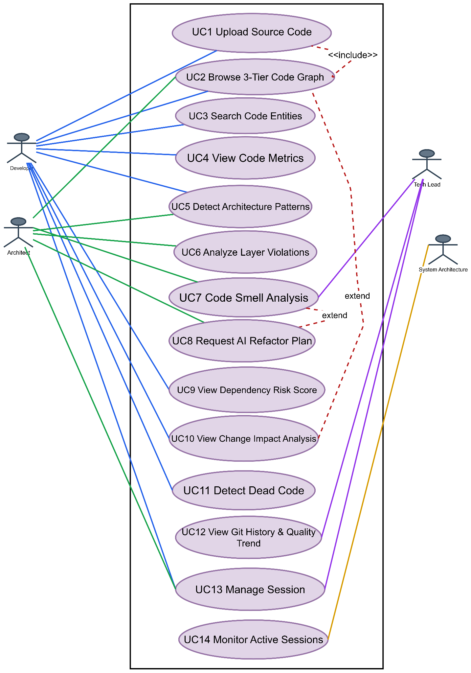
SYSTEM MODELING
Use Case Diagram
14 use cases spanning Developer, Architect, Tech Lead, and Administrator roles.
06

Slide 7
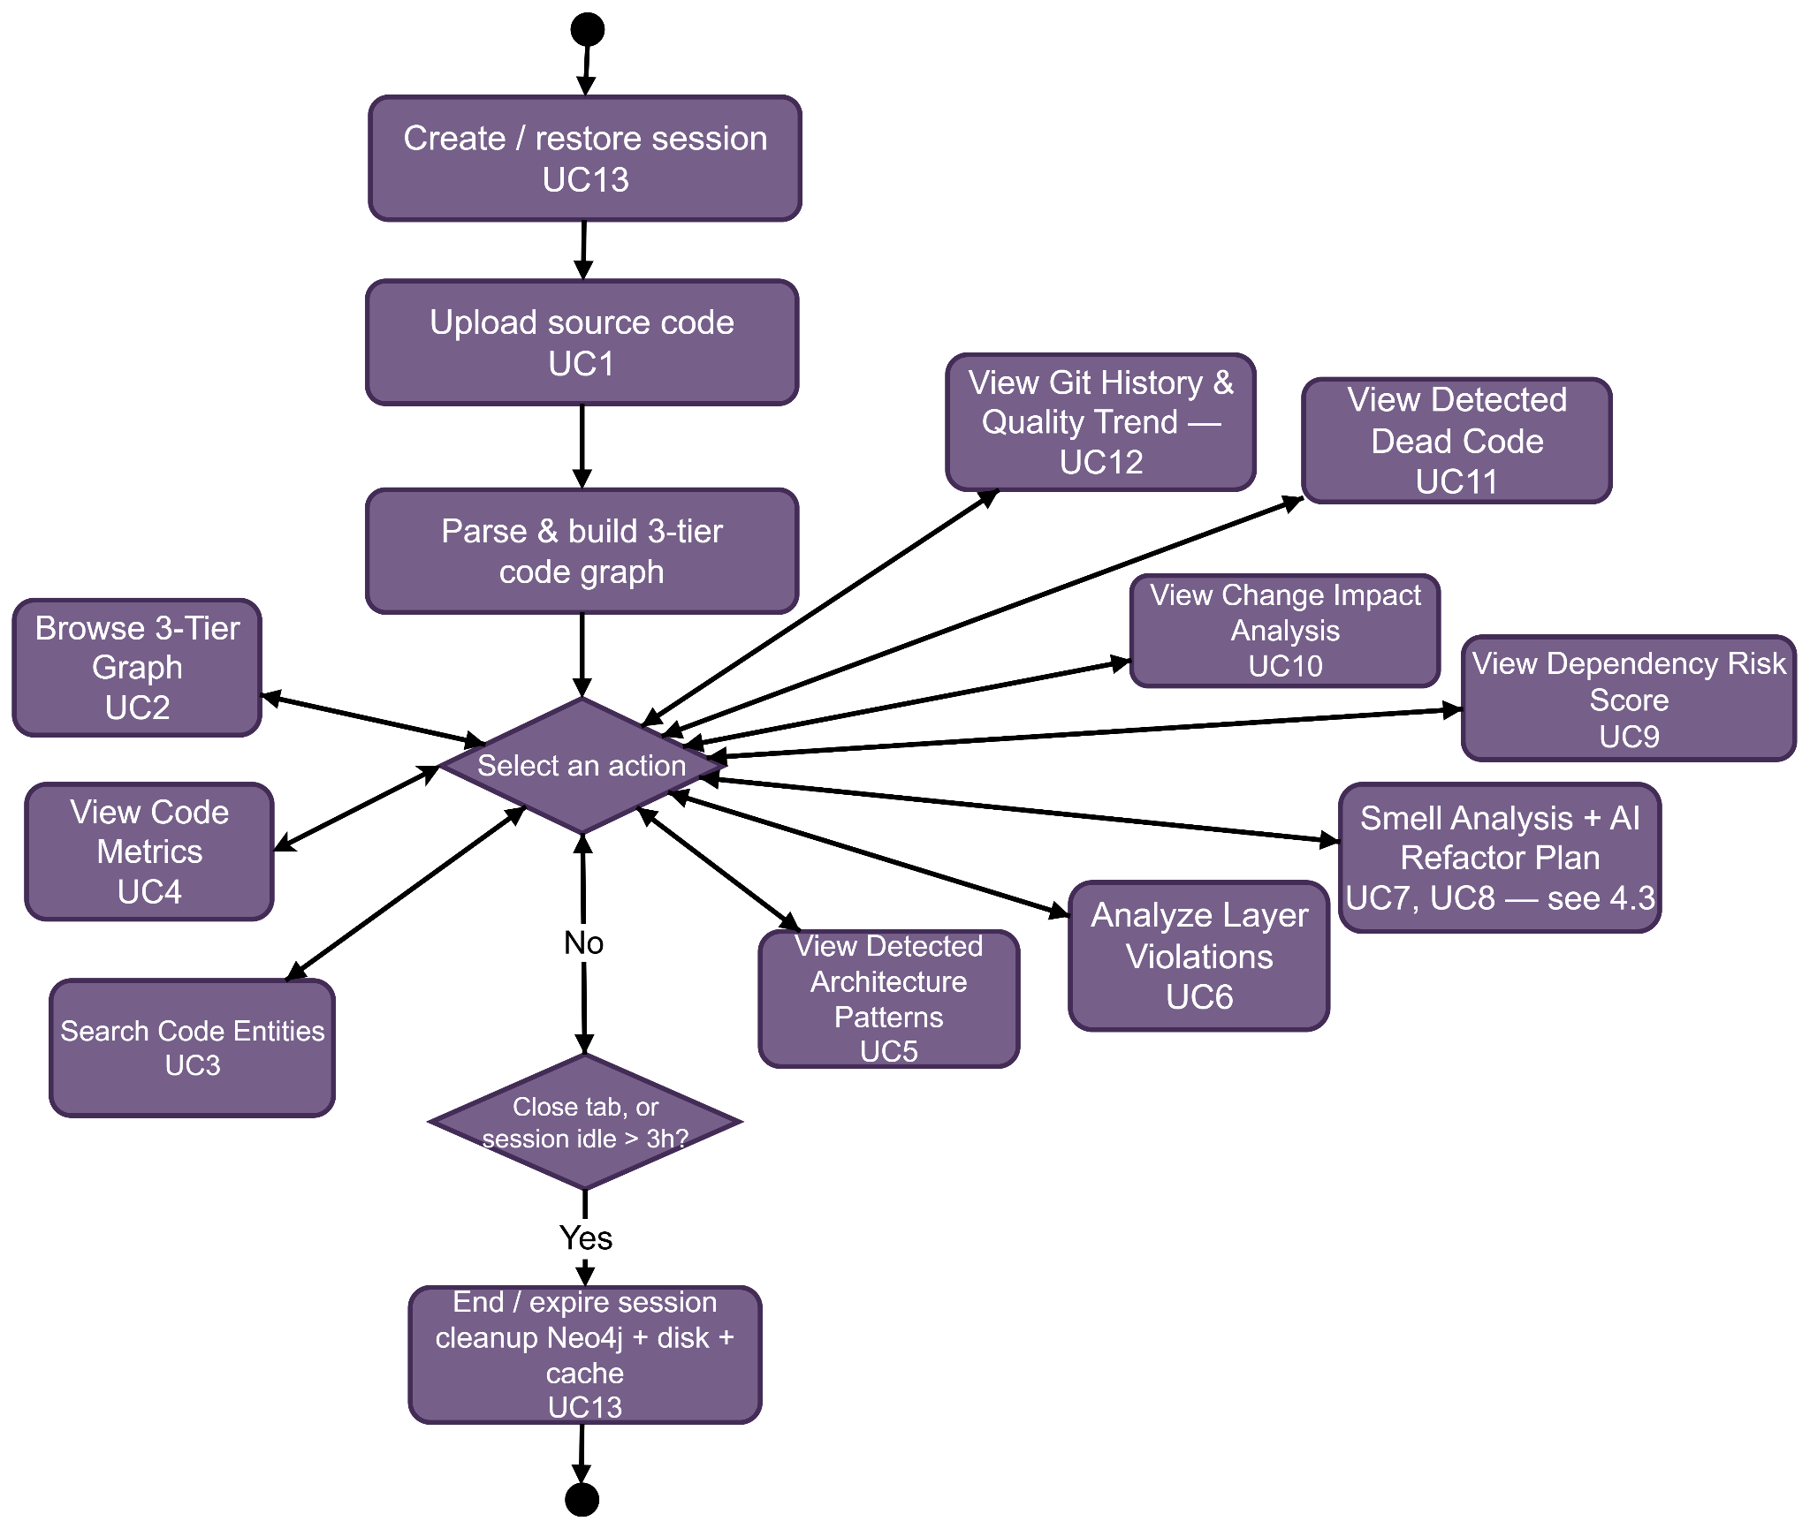
SYSTEM MODELING
Activity Diagram — System Operational Life Cycle
From session creation through upload, analysis, and automatic session expiry.
07

Slide 8
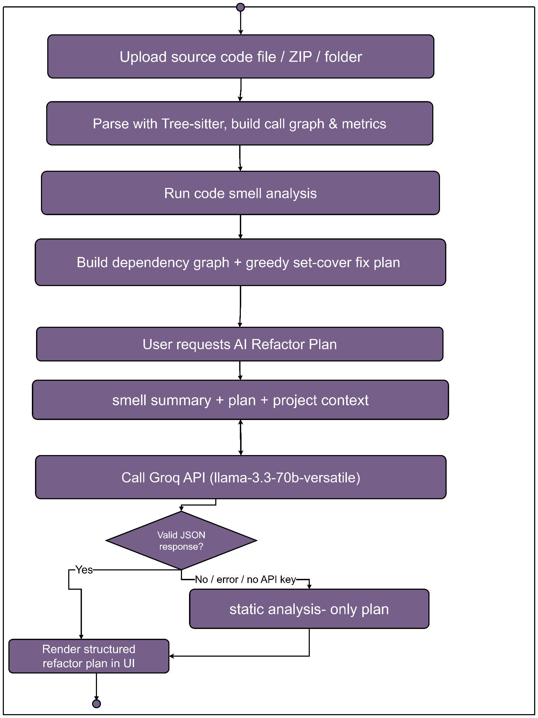
SYSTEM MODELING
Activity Diagram — Code Smell Detection Flow
Parsing, rule-based smell detection, and AI-assisted refactor planning in sequence.
08

Slide 9
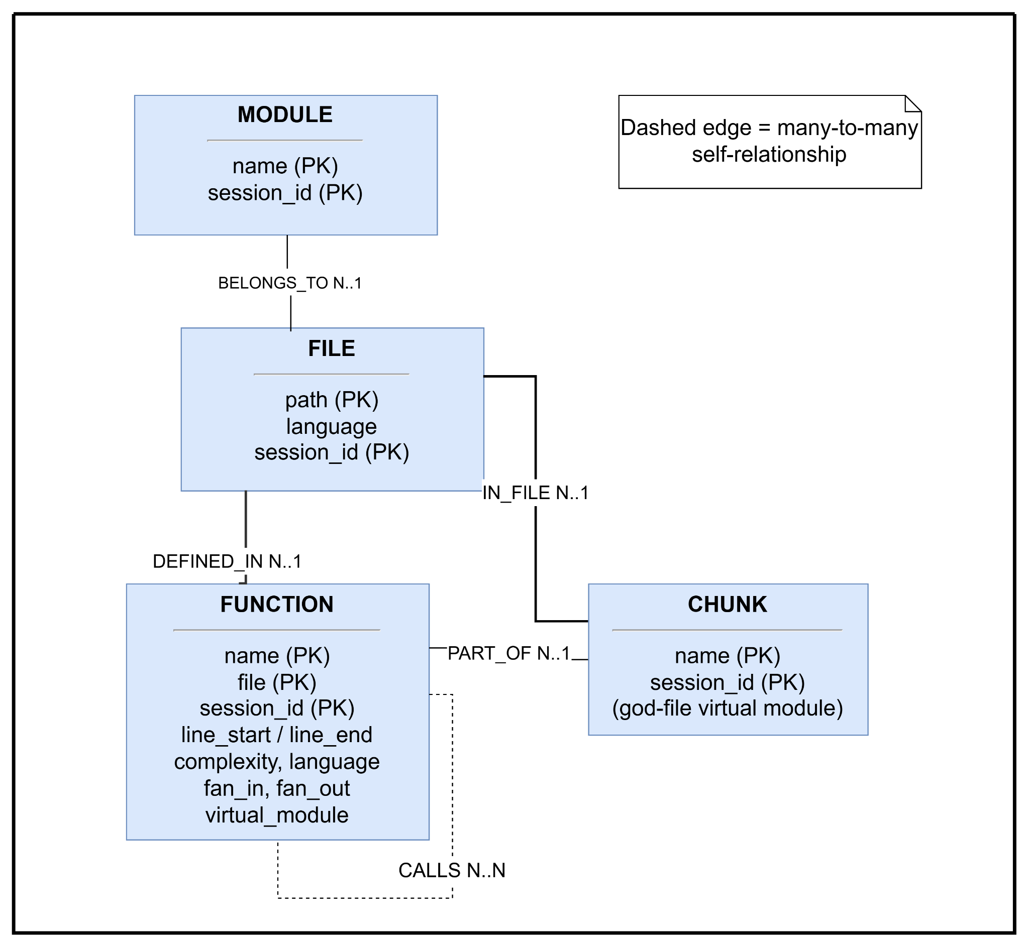
DATA MODELING
Entity- Relationship Diagram
09

Slide 10
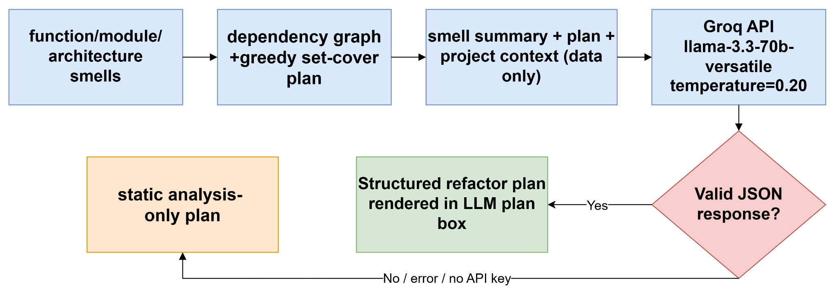
AI ENGINEERING
AI Refactor Plan — Engineering Pipeline
Static analysis runs first and always produces a plan; the LLM is invoked only on request, to add architectural judgment.
10

Slide 11
SECTION 2 OF 4
Live System Walkthrough
Screenshots of every working feature in the running application
11

Slide 12
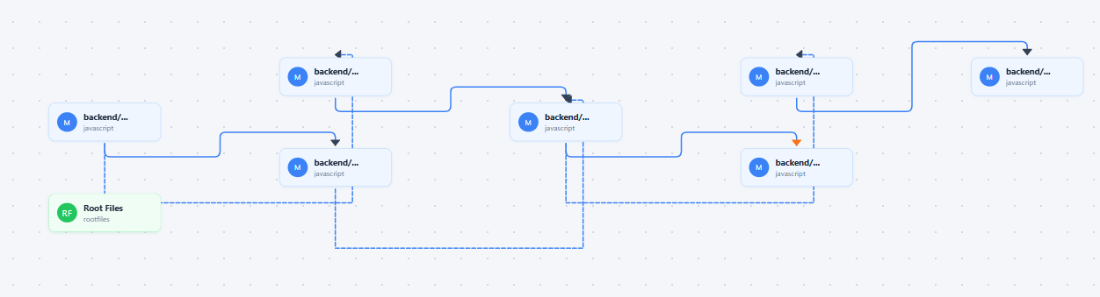
LIVE SYSTEM
3-Tier Graph Visualization
Tier 1 — Module graph
Click-to-drill-down navigation from modules, into files, into individual function call graphs.
12

Slide 13
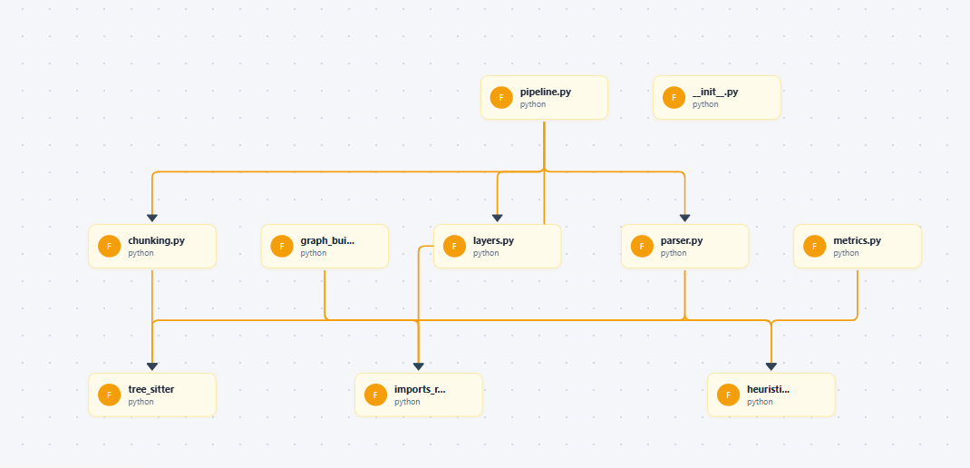
LIVE SYSTEM
3-Tier Graph Visualization
Tier 2 — File graph
Click-to-drill-down navigation from modules, into files, into individual function call graphs.
13

Slide 14
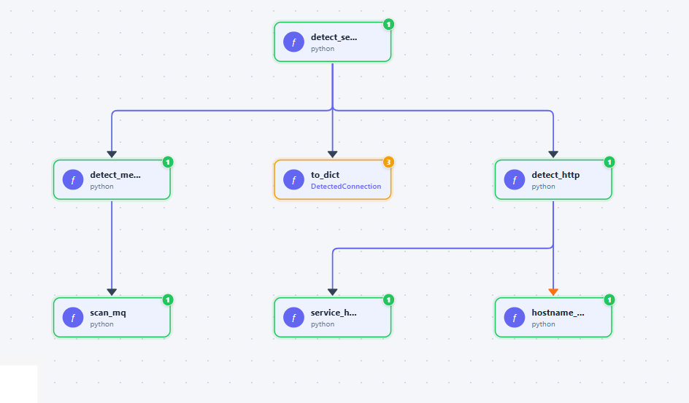
LIVE SYSTEM
3-Tier Graph Visualization
Tier 3 — Function graph
Click-to-drill-down navigation from modules, into files, into individual function call graphs.
14

Slide 15
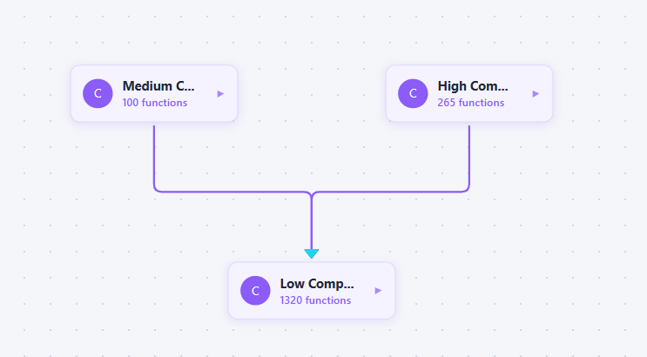
LIVE SYSTEM
God-File Chunking
Complexity-based virtual modules
A large file is split into virtual modules by complexity, with each chunk still drilling down to its own functions.
15

Slide 16
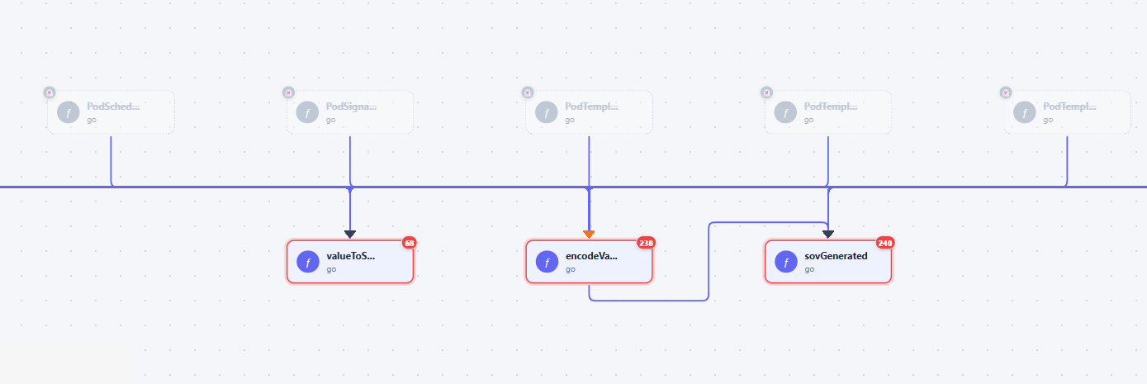
LIVE SYSTEM
God-File Chunking
Chunk-level function view
A large file is split into virtual modules by complexity, with each chunk still drilling down to its own functions.
16

Slide 17
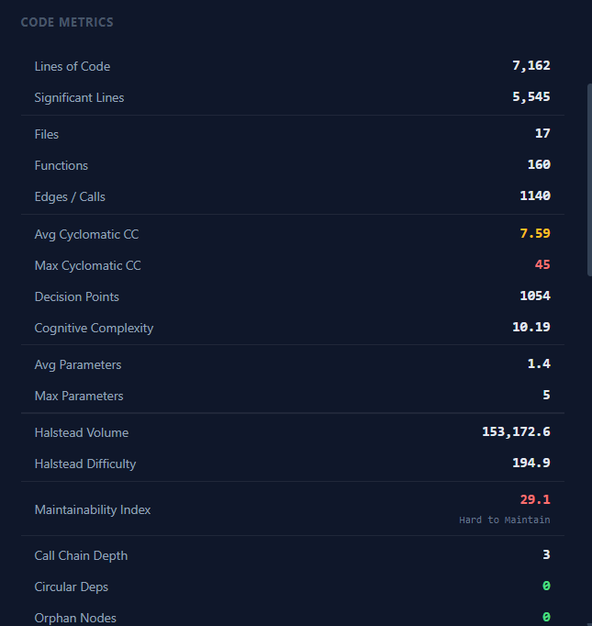
LIVE SYSTEM
Code Metrics Dashboard
LOC, cyclomatic complexity, Halstead metrics, and Maintainability Index computed per project.
17

Slide 18
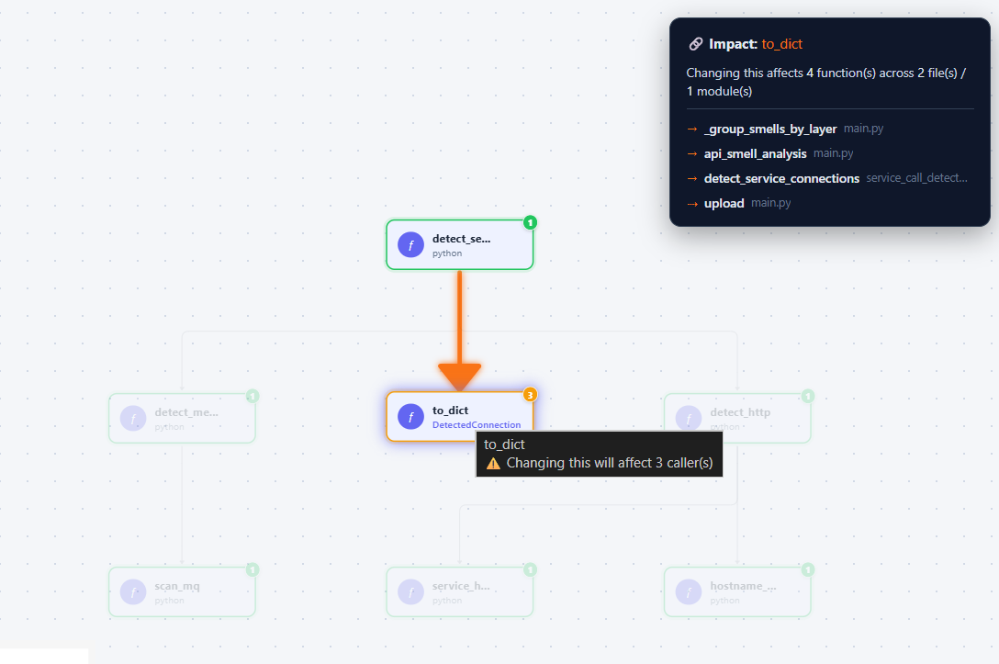
LIVE SYSTEM
Change Impact Analysis
Reverse call graph traversal (BFS) shows every function, file, and module a change will ripple into.
18

Slide 19
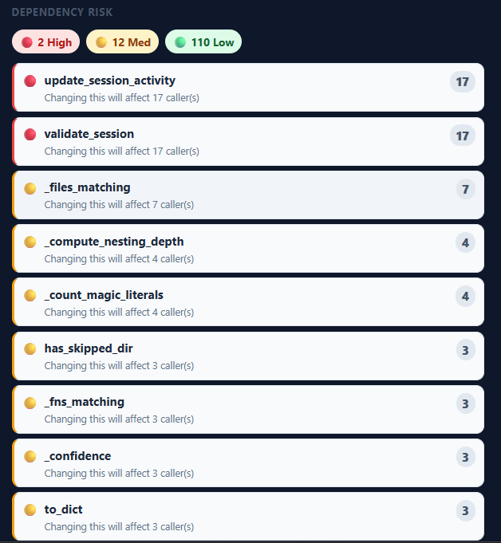
LIVE SYSTEM
Dependency Risk Scoring
Functions ranked High / Medium / Low / None risk based on fan-in (number of callers).
19

Slide 20
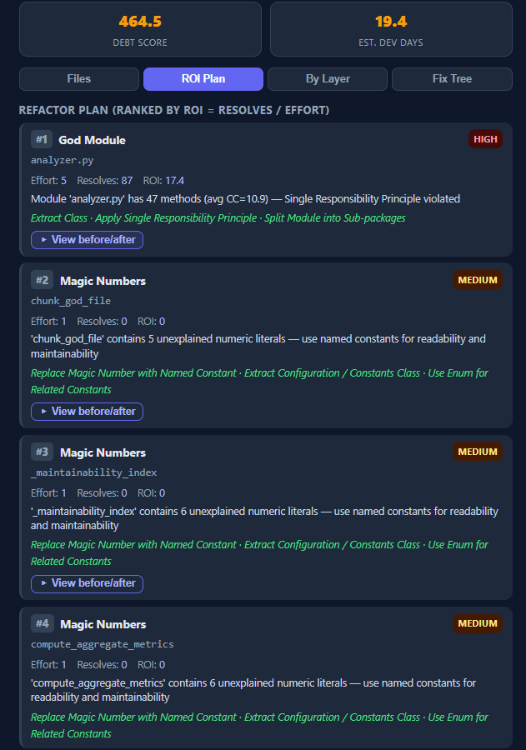
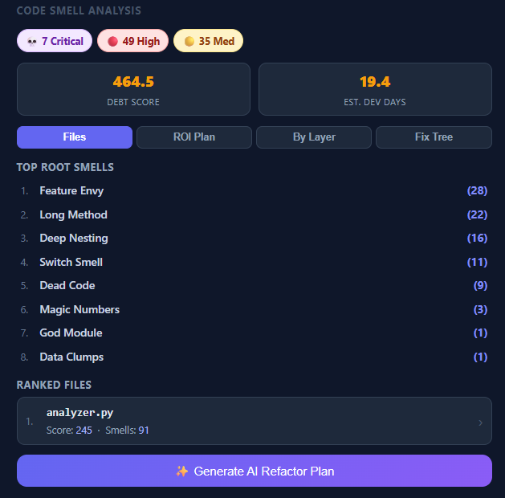
LIVE SYSTEM
Code Smell Analysis- Detection & Prioritization
20

Slide 21
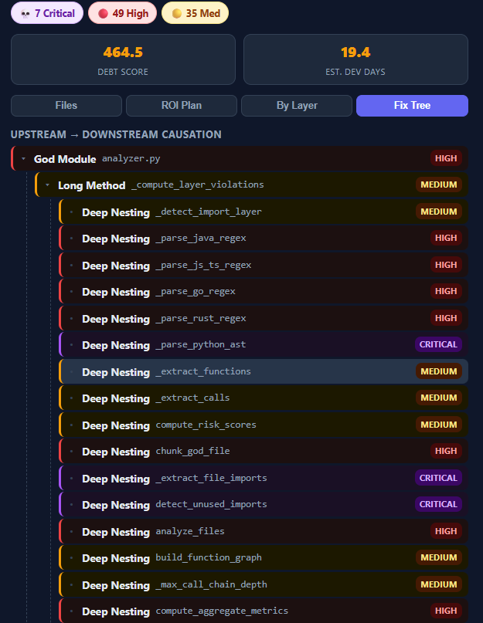
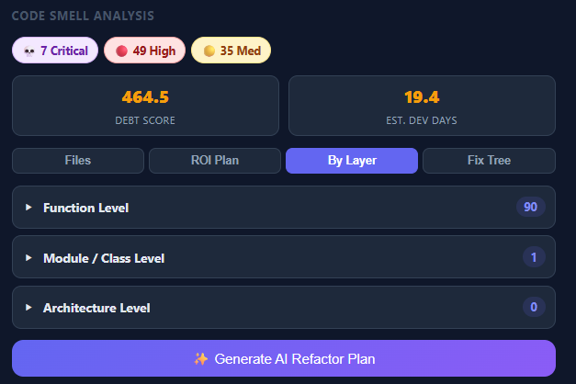
LIVE SYSTEM
Code Smell Analysis — Layers & Root Cause
Smells by architectural layer
Root-cause ranking traces how fixing one smell resolves several downstream ones.
21

Slide 22
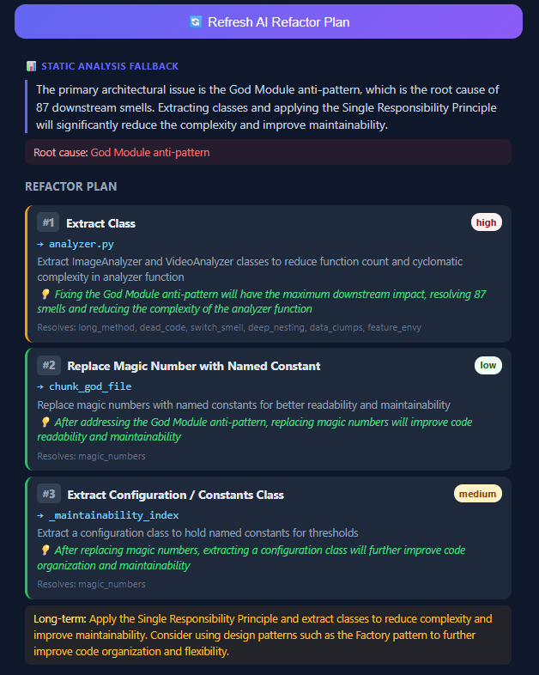
LIVE SYSTEM
AI-Powered Refactor Plan
Groq LLM (llama-3.3-70b) turns the smell summary into a prioritized, risk-assessed refactor plan.
22

Slide 23
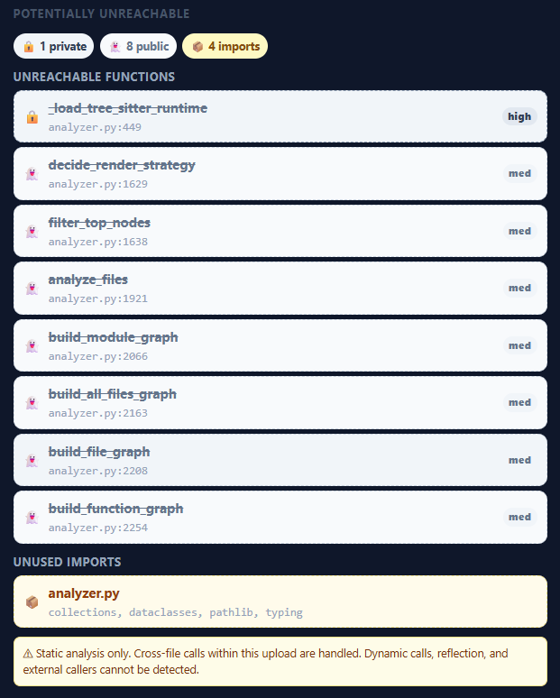
LIVE SYSTEM
Dead Code & Unused Import Detection
Unreachable functions flagged by confidence tier; unused imports listed per file.
23

Slide 24
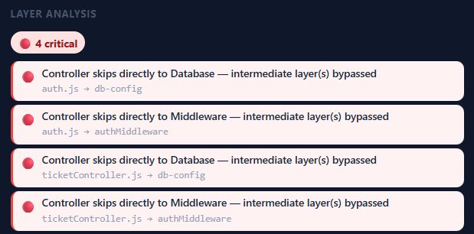
LIVE SYSTEM
Layer Violation Detection
Validates that calls flow Controller → Service → Repository → Model, reporting violations by severity.
24

Slide 25
SECTION 3 OF 4
Project Status
What's completed, in progress, and remaining
25

Slide 26
PROJECT STATUS
Completed Features
✓
3-tier graph visualization
✓
Code metrics dashboard & analysis
✓
Change impact analysis of functions
✓
Code smell detection + refactor plan (static & LLM-based)
✓
Unused function and unused import detection
✓
Dependency risk score detection
✓
Layer violation detection
26

Slide 27
PROJECT STATUS
In Progress & Remaining
IN PROGRESS
REMAINING
◐
Git history and metrics tracking across commits
○
Design pattern detection (GoF patterns)
◐
Architecture pattern detection refinement
27

Slide 28
SECTION 4 OF 4
Challenges Faced
The major hurdles encountered during development
28

Slide 29
CHALLENGES FACED
Major Hurdles
Multi-language parsing
God-file handling
User-friendly UI
Reliable Tree-sitter + regex-fallback parsing and accurate cross-file call graphs across 6+ languages.
Splitting huge files into virtual modules without breaking the graph UI or severing related functions.
Presenting dense analytical data (metrics, smells, risk scores) in a way that's still easy to read.
False-positive control
LLM reliability
Session consistency
Confidence tiers instead of binary flags, since dead code and smells are often genuinely ambiguous.
A deterministic fallback plan plus prompt design that reliably returns parseable AI output.
Keeping in-memory cache, Neo4j, and disk uploads in sync per session under concurrent requests.
29

Slide 30
Thank You
Questions & Discussion

